Slide 1

Programming in Java
Abstract class and Interface
By
Ravi Kant Sahu
Asst. Professor, LPU

Slide 2
Contents
Abstract Class
Object Class
Ravi Kant Sahu, Asst. Professor @ Lovely Professional University, Punjab (India)

Slide 3
Abstract Class
An abstract class is a class that is declared abstract.
An abstract method is a method that is declared without an implementation (without braces, and followed by a semicolon), like this:
abstract void moveTo(double deltaX, double deltaY);
Abstract class may or may not include abstract methods.
Abstract classes cannot be instantiated, but they can be sub-classed.
Ravi Kant Sahu, Asst. Professor @ Lovely Professional University, Punjab (India)

Slide 4
If a class includes abstract methods, the class itself must be declared abstract, as in:
public abstract class GraphicObject
{ // declare fields
// declare non-abstract methods
abstract void draw();
}
NOTE:
When an abstract class is sub-classed, the subclass usually provides implementations for all of the abstract methods in its parent class.
However, if it does not, the subclass must also be declared abstract.
Ravi Kant Sahu, Asst. Professor @ Lovely Professional University, Punjab (India)

Slide 5
It can be considered as a blank form consisting of several sections, some of them may be optional (non-abstract method) and some may be mandatory (abstract)…
Can we Override a constructor?
If yes, How? if No, Why?
Ravi Kant Sahu, Asst. Professor @ Lovely Professional University, Punjab (India)

Slide 6
abstract class Bike{
abstract void run();
}
class Honda4 extends Bike{
void run(){System.out.println("running safely..");}
public static void main(String args[]){
Bike obj = new Honda4();
obj.run();
}
}

Slide 7
Interfaces
Ravi Kant Sahu, Asst. Professor @ Lovely Professional University, Punjab (India)

Slide 8
Interfaces
An interface is a collection of abstract methods.
An interface is not a class.
A class describes the attributes and behaviors of an object whereas an interface contains behaviors that a class implements.
A class implements an interface, thereby inheriting the abstract methods of the interface.
Unless the class that implements the interface is abstract, all the methods of the interface need to be defined in the class.
Ravi Kant Sahu, Asst. Professor @ Lovely Professional University, Punjab (India)

Slide 9
Properties of Interfaces
The interface keyword is used to declare an interface.
Interfaces have the following properties:
  An interface is implicitly abstract. We do not need to use the abstract keyword when declaring an interface.
  Each method in an interface is also implicitly public and abstract, so the abstract keyword is not needed.
  Each variable in an interface is implicitly public, static and final.
Ravi Kant Sahu, Asst. Professor @ Lovely Professional University, Punjab (India)

Slide 10
Interface Vs Class
An interface is similar to a class in the following ways:
An interface can contain any number of methods.
An interface is written in a file with a .java extension, with the name of the interface matching the name of the file.
The byte-code of an interface appears in a .class file.
Interfaces appear in packages, and their corresponding byte-code file must be in a directory structure that matches the package name.
Ravi Kant Sahu, Asst. Professor @ Lovely Professional University, Punjab (India)

Slide 11
Interface Vs Class
An interface is different from a class in several ways, including:
We cannot instantiate an interface.
An interface does not contain any constructors.
All of the methods in an interface are abstract.
An interface is not extended by a class; it is implemented by a class.
An interface can extend multiple interfaces.
Ravi Kant Sahu, Asst. Professor @ Lovely Professional University, Punjab (India)

Slide 12
Implementing Interfaces
When a class implements an interface, then it has to perform the specific behaviors of the interface.
If a class does not perform all the behaviors of the interface, the class must declare itself as abstract.
A class uses the implements keyword to implement an interface.
The implements keyword appears in the class declaration following the extends portion of the declaration.
Ravi Kant Sahu, Asst. Professor @ Lovely Professional University, Punjab (India)

Slide 13
Example
interface Animal
{
void eat();
public void travel();
}
Ravi Kant Sahu, Asst. Professor @ Lovely Professional University, Punjab (India)

Slide 14
Example
public class Mammal implements Animal
{
public void eat()
{
System.out.println("Mammal eats");
}
public void travel()
{
System.out.println("Mammal travels");
}
public int noOfLegs()
{ return 0; }
public static void main(String args[])
{
Mammal m = new Mammal();
m.eat();
m.travel();
}
}
Ravi Kant Sahu, Asst. Professor @ Lovely Professional University, Punjab (India)

Slide 15
Abstract Class Vs Interfaces
Abstract Class | Interface
May contain non-abstract methods and non-static non final data members | Contains only method declaration and static final data members
Multiple Inheritance is not supported through classes | Multiple Inheritance through Interfaces is supported
Classes provide static classing environment | Interfaces provide dynamic classing environment
Inheritance using ‘extends’ keyword | Inheritance using ‘implements’ keyword
Ravi Kant Sahu, Asst. Professor @ Lovely Professional University, Punjab (India)

Slide 16
Object Class
There is one special class, called Object, defined by Java.
All other classes are subclasses of Object.
A reference variable of type Object can refer to an object of any other class.
Arrays are implemented as classes, so a variable of type Object can also refer to any array.
In Object class, getClass( ), notify( ), notifyAll( ), and wait( ) are declared as final.
Ravi Kant Sahu, Asst. Professor @ Lovely Professional University, Punjab (India)

Slide 17
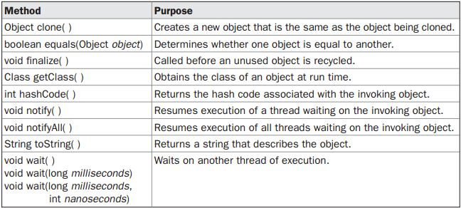
Methods in Object class
Ravi Kant Sahu, Asst. Professor @ Lovely Professional University, Punjab (India)

Slide 18


